Slide 1
THE EASY FOOD
-----------------------------------------------------------------------------------------------

Slide 2
MADE BY – ANIKET KUMAR

Slide 3
CONTENT
PURPOSE
FEATURES
WORKING
BACKEND

Slide 4
PURPOSE
With the improvement of technology, online food ordering systems are becoming a popular topic. That's because they are serving the increasing demand for convince. The main purpose of an online ordering system is to provide customers for a way to place an order at a restaurant over the internet.
The main reason is that it benefits both the customer and the business . With a website or mobile app, customers can easily browse all the dishes the restaurant has available, customize dishes to their requirements and place an order. It can also save their favourite orders allowing them to easily re-order that in the future. The target market also used to be busy people who needed a restaurant delivery service because they didn’t have time. Now, the target market is everyone. Most people now require home deliveries.
With a number of restaurants opening in every nook and corner of cities which have brought in a number of international and national cuisines, people have been looking forward to trying their food. Not everyone can go and dine at a restaurant, hence, the on demand food delivery app development came into being, which not only made it easy for the customers to enjoy scrumptious food at the leisure of their home but also offered a wide variety of cuisines from across the globe.

Slide 5
FEATURES
NATIVE ANDROID APPLICATION
CLASSIFIED PRODUCT
EASY ADD TO CART WITH ONE CLICK
MANAGE AND MODIFY DELIVERY ADDRESS
USER MENU
MANAGE ORDER
MANAGE PROFILE

Slide 6
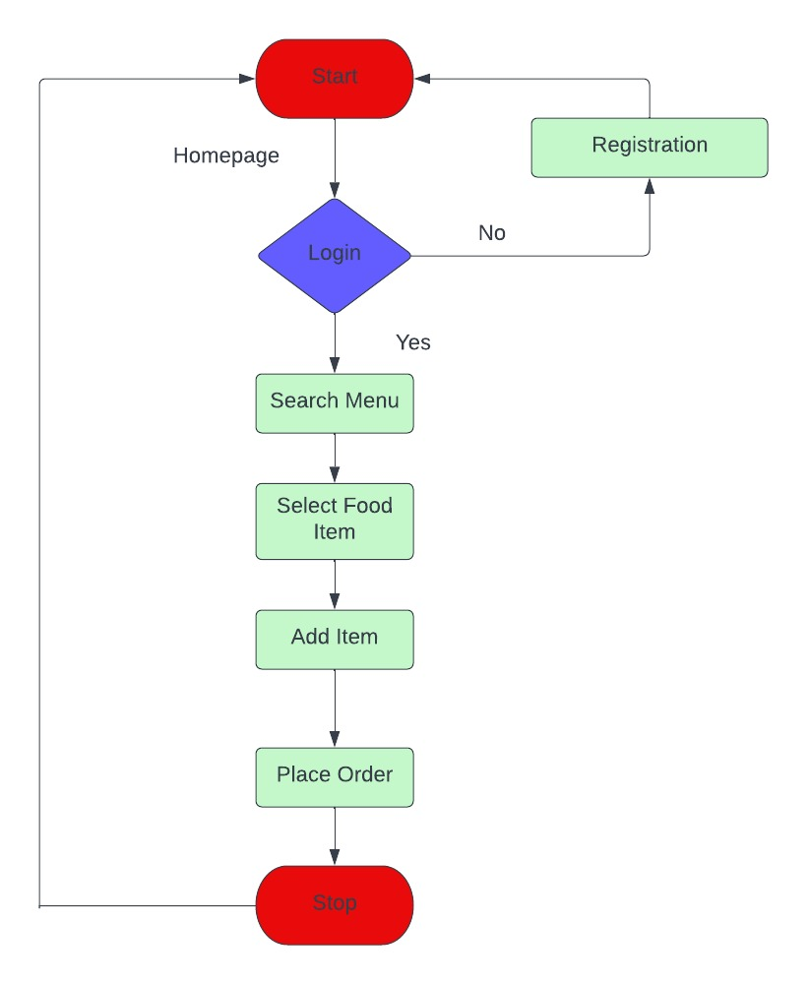
ER DIAGRAM

Slide 7
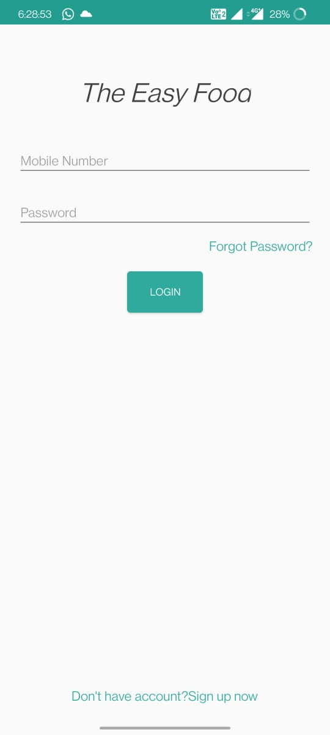
LOGIN PAGE
This is the login page . New users will have to signup while the existing users can sign in through their user_id and password .

Slide 8
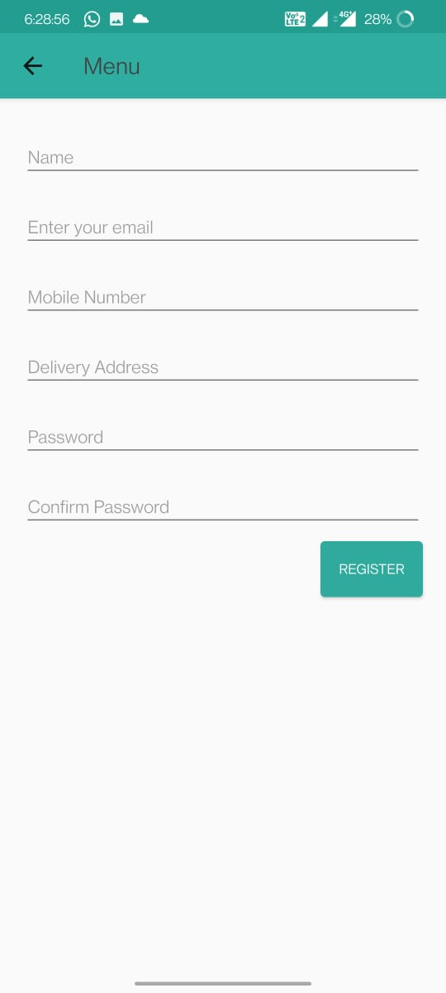
SIGN UP PAGE
This is the sign up page for the new users. New user have to sign up for using it.

Slide 9
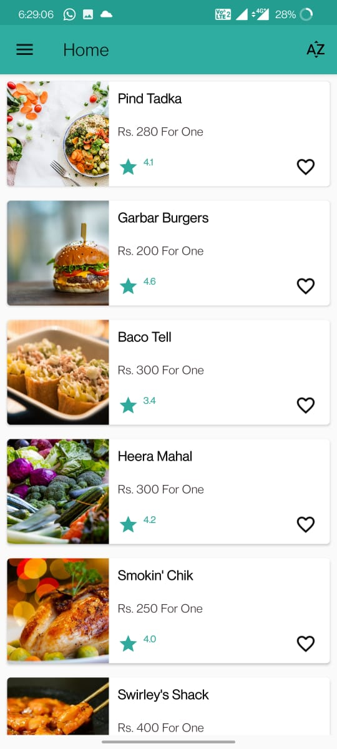
ORDERING SCREEN
HERE YOU WILL SEE THE MANY RESTURANTS
YOU CAN SELECT ANY RESTURANT AND ADD FOOD TO YOUR CART

Slide 10
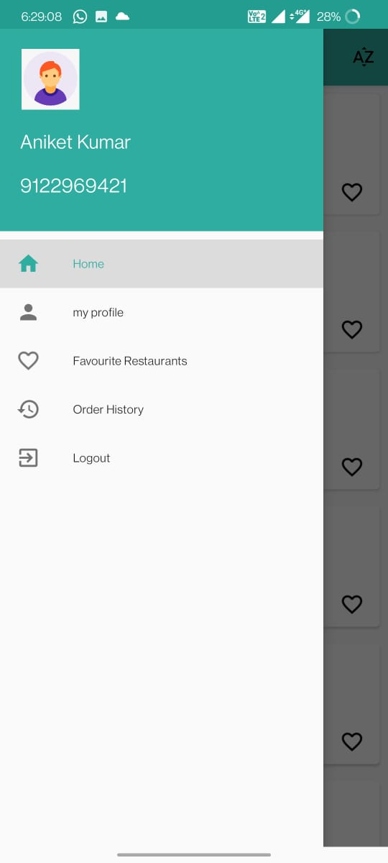
MENU CATAGORIES
HOME
MY PROFILE
FAVOURITE RESTURANTS
ORDER HISTORY
LOGOUT

Slide 11
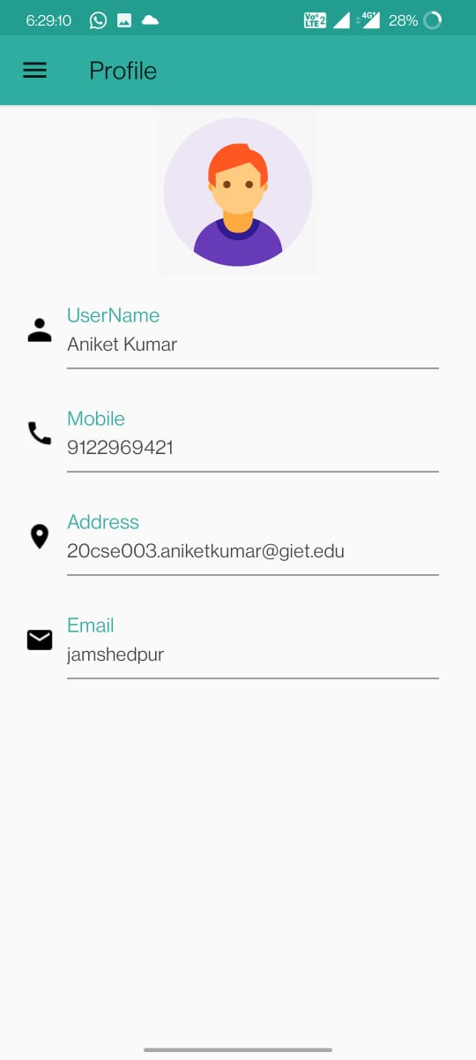
MY PROFILE
IN MY PROFILE SECTION YOU CAN SEE YOUR PROFILE INFORMATION
IN MY PROFILE SECTION YOU CAN EDIT YOUR INFORMATION AND DETAILS

Slide 12
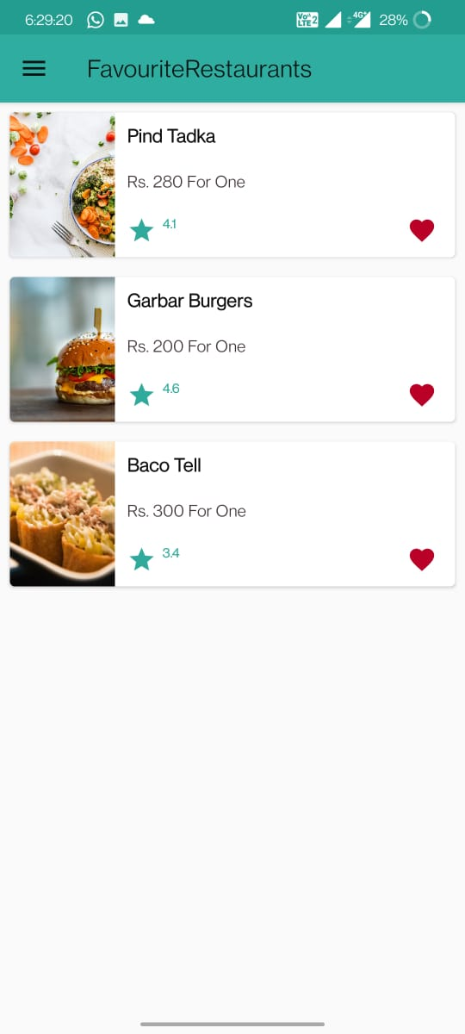
FAVOURITE RESTAURANTS
IN FAVOURITE RESTAURANTS SECTION YOU CAN ADD YOUR FAVORITE RESTURANTS
FOR REACHING TO YOUR FAVOURITE RESTAURANTS

Slide 13
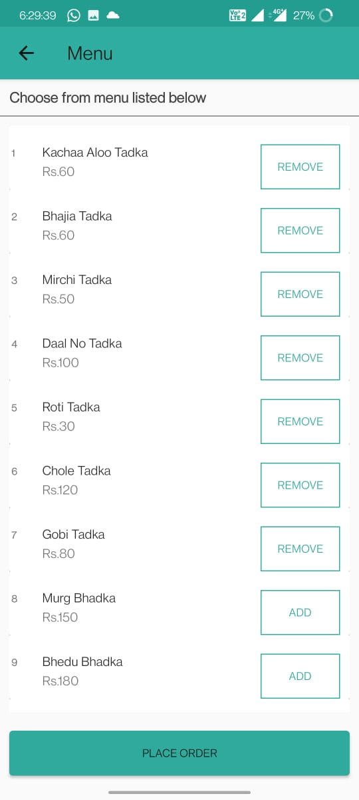
ORDERING SCREEN
MENU LIST
HERE YOU GET A LIST OF FOODS BY THE RESTAURANT THAT YOU WISH TO ORDER

Slide 14
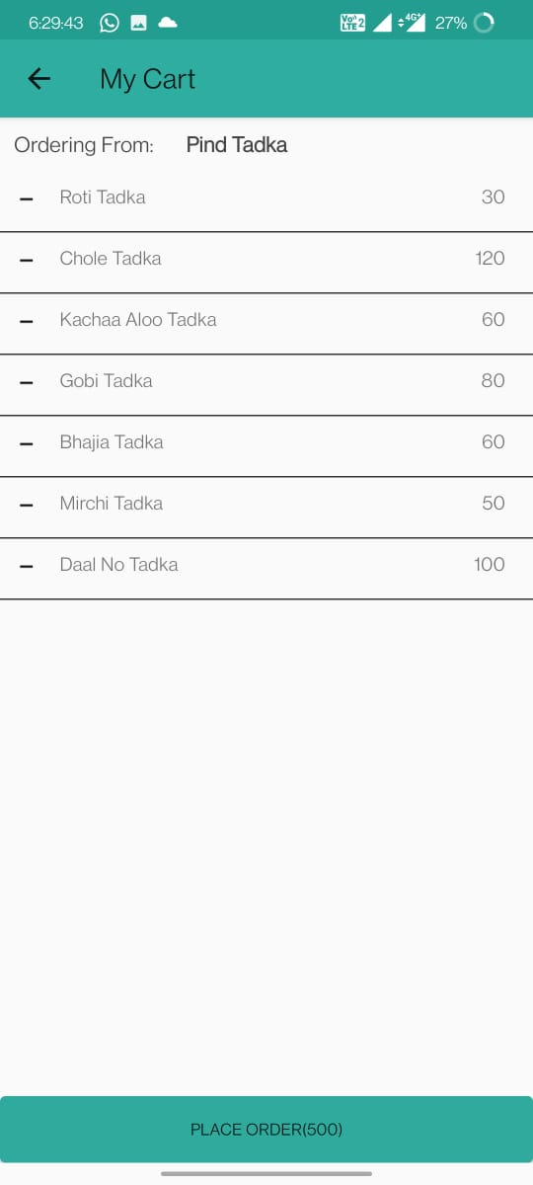
MY CART
THE FOODS THAT YOU HAVE ADDED WILL BE DISPLAYED HERE

Slide 15
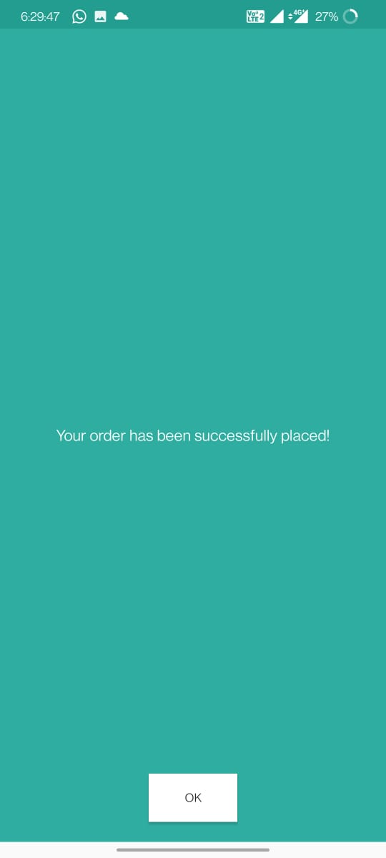
ORDER SUCCESSFULLY PLACED
THIS LAYOUT SHOWS THAT YOUR ORDER HAVE BEEN SUCCESSFULLY PLACED

Slide 16
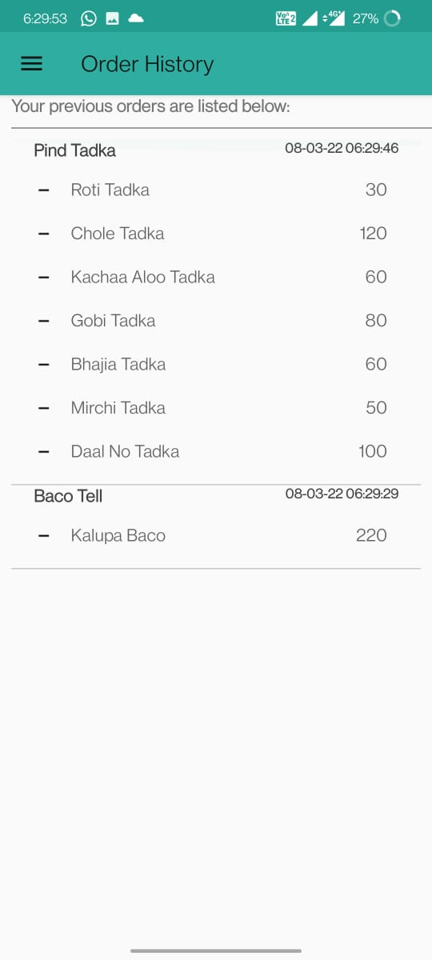
ORDER HISTORY
YOU CAN TRACK YOUR RECENT ORDERS FOR REODERING YOUR FOODS

Slide 17
THANK YOU

